Slide 1
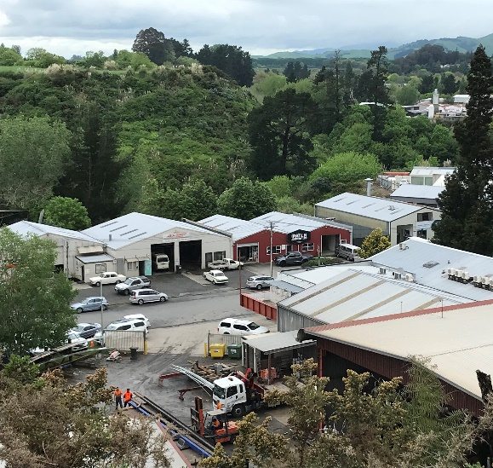
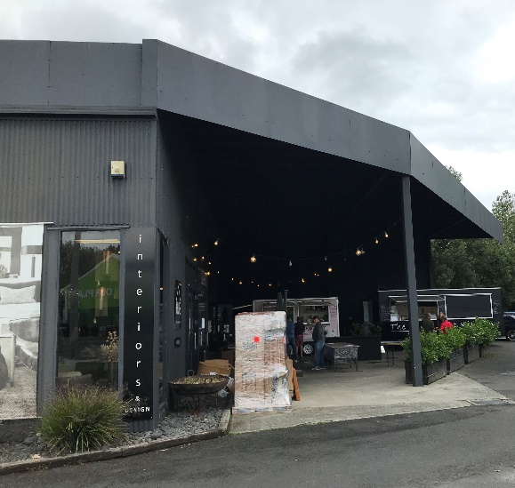
Carter’s Flat – Local Area Plan and Plan Change
Stakeholder Consultation

Slide 2
Purpose of today
Share what has been done so far
Outline opportunities/constraints identified for the area
Feedback on key moves in Local Area Plan
Feedback on how this translates into the Plan Change

Slide 3
So far...
A draft Local Area Plan (LAP).
Key moves for Council e.g. Streetscapes, intersection upgrades etc
To be rezoned as Commercial Zone which generally provides for large format commercial activity (>1000m²).
New rules identified for Carter’s Flat relating to:
Glazing/windows
Parking areas
Setbacks/landscaping

Slide 4
LAP Principles
A vibrant commercial centre that is complimentary to, and does not undermine the role of, the Cambridge Central Business Area
Connect to and integrate with Lake Te Koo Utu and the Karapiro Stream.
Create a high-quality commercial environment that supports economic growth in Cambridge.
The transportation network supports safe, efficient and multi-modal methods of travel and connects with the existing business areas in Cambridge.
Recognise and respect the cultural significant and history of Carter’s Flat

Slide 5
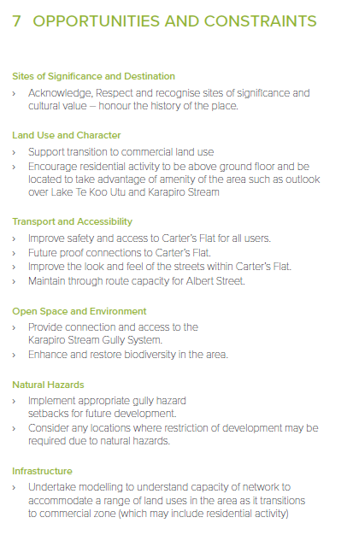
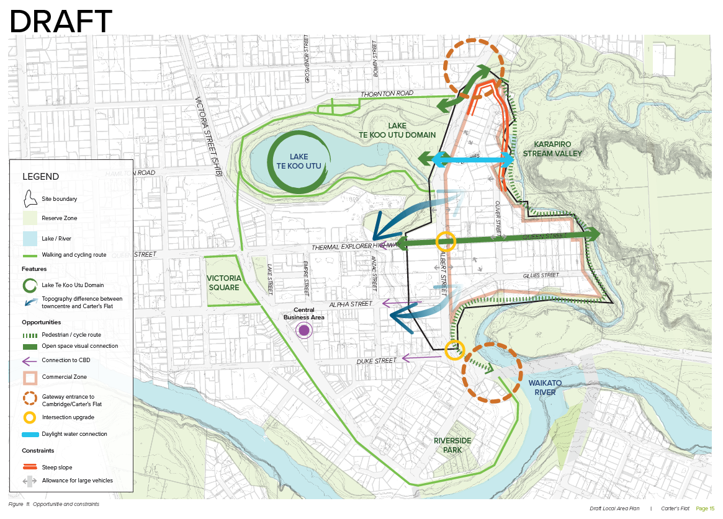
Opportunities and Constraints

Slide 6
Key Moves – Transport and Accessibility

Slide 7
Key Moves – Land Use and Experience

Slide 8
Large Format Retail
What does large format retail look like?

Slide 9
Roading & Traffic

Slide 10
Impact of the plan change affecting business operations

Slide 11
Key points for feedback
Urban design outcomes i.e. glazing, setbacks,
These will be reflected in the Plan Change through policies and rules.
Residential
Social heart/central space

Slide 12
Project Timeline
April – Workshop with landowners and key stakeholders
May – Final draft of Local Area Plan and Plan Change
June/July – Statutory Consultation
September – Notification of Plan Change 19
Opportunity to submit

